Slide 1


Computer-Aided Design VHDL Notes II
Mahdi Aminian
Some slides courtesy of:
“Hardware Systems Modeling”, A. Vachoux, EPFL
CAD slides from Dr. Saheb Zamani

Slide 2
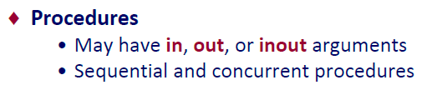
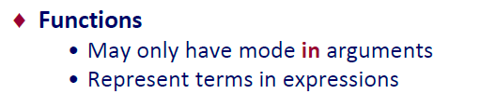
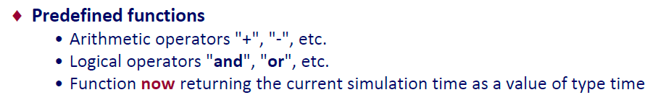
Subprograms
Are used as expression in other VHDL statements (concurrent or sequential)

Slide 3
Subprograms
Sequential Execution
Functions
function name can be an operator
arbitrary number of input parameters
exactly one return value
no WAIT statement allowed
function call <=> VHDL expression
Procedures
arbitrary number of parameters of any possible direction (input/output/inout)
RETURN statement optional (no return value!)
procedure call <=> VHDL statement
WAIT is allowed (if its parent is not a function)
Subprograms can be overloaded
Parameters can be constants, signals, variables or files

Slide 4
Example of Procedure
architecture EXAMPLE of PROCEDURES is procedure COUNT_ZEROS (A: in std_logic_vector; signal Q: out integer) is variable ZEROS : integer; begin ZEROS := 0; for I in A'range loop if A(I) = '0' then ZEROS := ZEROS +1; end if; end loop; Q <= ZEROS;
end COUNT_ZEROS; signal COUNT: integer; signal IS_0: boolean; begin process begin IS_0 <= true; COUNT_ZEROS("01101001", COUNT); wait for 0 ns; if COUNT > 0 then IS_0 <= false; end if; wait; end process; end EXAMPLE;
Are used as VHDL statements (concurrent or sequential)
No return value
Parameter values may be updated (mode out/inout)
Body split into declarative and definition part
Unconstrained parameters possible (array size remains unspecified)
For out parameters, default: variable

Slide 5
Example of Function
architecture EXAMPLE of FUNCTIONS is [(im)pure] function COUNT_ZEROS (A: bit_vector) return integer is variable ZEROS : integer; begin ZEROS := 0; for I in A'range loop if A(I) = '0' then ZEROS := ZEROS +1; end if; end loop; return ZEROS; end COUNT_ZEROS; signal WORD: bit_vector(15 downto 0); signal WORD_0: integer; signal IS_0: boolean; begin WORD_0 <= COUNT_ZEROS(WORD); process begin IS_0 <= true; if COUNT_ZEROS("01101001") > 0 then IS_0 <= false; end if; wait; end process; end EXAMPLE;
(Im)pure declaration optional (default: 'pure’)
Body split into declarative and definition part
Unconstrained parameters possible (array size remains unspecified)
Are used as expression in other VHDL statements (concurrent or sequential)

Slide 6
Subprogram Declaration and Overloading
Subprograms may be declared/defined in any declaration part
package
entity
architecture
process
subprogram
Overloading of subprograms possible
identical name
different parameters
During compilation/runtime that subprogram is called whose formal parameters match the provided actuals
Cannot overload with different parameter classes.

Slide 7
Subprogram Declaration and Overloading
توابع Impure به objectهاي بيرون ازscope خود دسترسي دارند.
زيربرنامه اي که در package اعلان شده باشد در همة واحدهايي که به اين package ارجاع مي دهند قابل دسترسي است.
زيربرنامه اي که در زيربرنامة ديگري اعلان شده باشد فقط در بدنة زيربرنامة parent آن قابل دسترسي است.
با overload کردن علائم مي توان مثلاً + را براي bit_vector ها هم استفاده کرد.
مانند پکیج‌های std_logic_unsigned و std_logic_signed

Slide 8
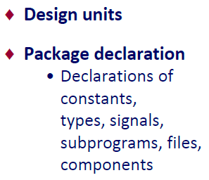
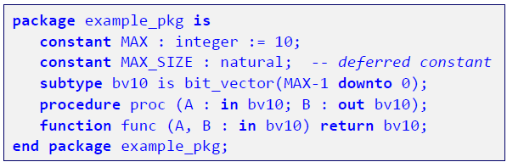
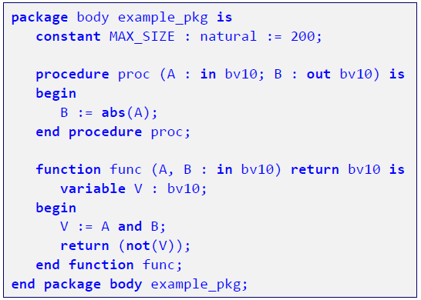

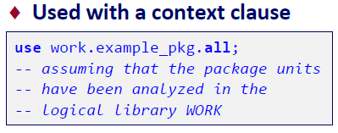
Package Declaration & Body

Slide 9
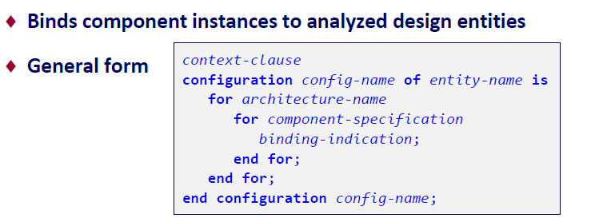


Configuration Declaration

Slide 10
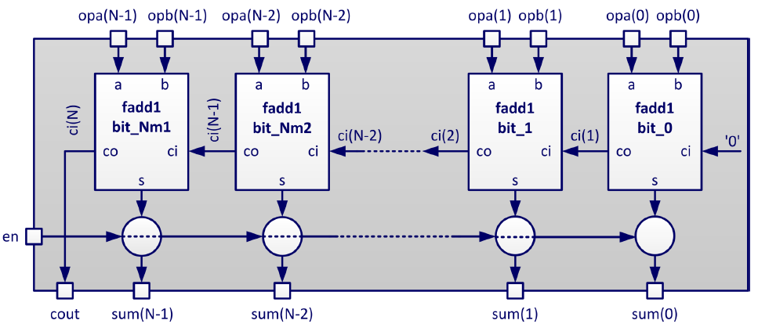
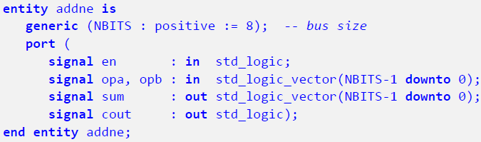
Generic N-bit Adder Using Components

Slide 11
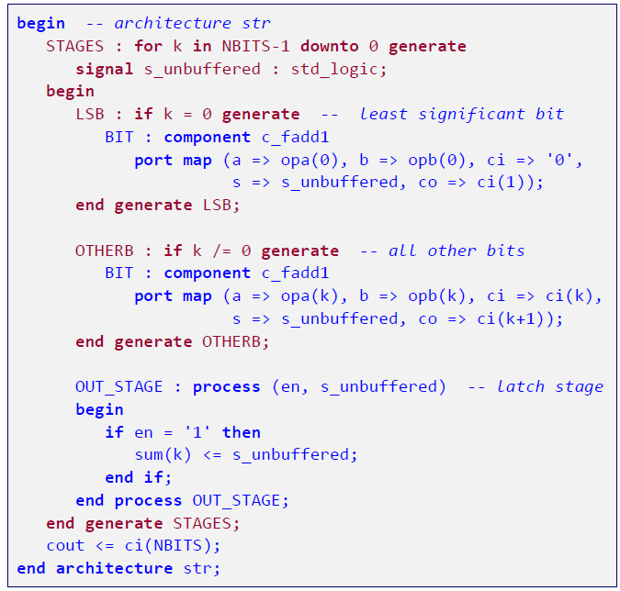
Generic N-bit Adder Using Components

Slide 12
Types of Assignment for 'bit' Data Types
architecture EXAMPLE of ASSIGNMENT is signal Z_BUS : bit_vector (3 downto 0); signal BIG_BUS : bit_vector (15 downto 0); begin -- legal assignments: Z_BUS(3) <= ’1’; Z_BUS <= ”1100”; Z_BUS <= b”1100”; Z_BUS <= x”c”; Z_BUS <= X”C”; BIG_BUS <= B”0000_0001_0010_0011”; end EXAMPLE;
Single bit values are enclosed in '.'
Vector values are enclosed in "..."
optional base specification (default: binary)
values may be separated by underscores to improve readability

Slide 13
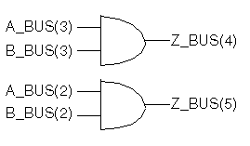
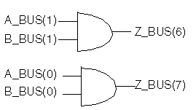
Logical Operations with Arrays
architecture EXAMPLE of LOGICAL_OP is signal A_BUS, B_BUS : bit_vector (3 downto 0); signal Z_BUS : bit_vector (4 to 7); begin Z_BUS <= A_BUS and B_BUS; end EXAMPLE;
Operands of the same length and type
Assignment via the position of the elements (according to range definition)

Slide 14

Comparison Operations with Arrays
architecture EXAMPLE of COMPARISON is signal PART: bit_vector(3 downto 0); signal BYTE: bit_vector(0 to 7); begin PART <= "1001"; BYTE <= "00001111"; COMPARE: process (PART, BYTE) begin if (PART < BYTE) then -- evaluated as: -- if (PART(3) < BYTE(0)) or -- ((PART(3) = BYTE(0)) and -- (PART(2) < BYTE(1))) or -- ((PART(3) = BYTE(0)) and -- (PART(2) = BYTE(1)) and -- (PART(1) < BYTE(2))) or ... -- better: if (( "0000"& PART) <= BYTE) then ... end EXAMPLE;
Arrays:
may differ in length
left-alignment prior to comparison
are compared element after element
No numerical interpretation (unsigned, 2-complement, etc.)
Adjust the length of arrays prior to comparison

Slide 15
Records
architecture EXAMPLE of AGGREGATE is type MONTH_NAME is (JAN, FEB, MAR, APR, MAY, JUN, JUL, AUG, SEP, OCT, NOV, DEC); type DATE is record DAY: integer range 1 to 31; MONTH: MONTH_NAME; YEAR: integer range 0 to 4000; end record; type PERSON is record NAME: string (0 to 8); BIRTHDAY: DATE; end record; signal TODAY: DATE; signal STUDENT_1: PERSON; signal STUDENT_2: PERSON; begin TODAY <= (26, JUL, 2010); STUDENT_1 <= (“Ali", TODAY); STUDENT_2 <= STUDENT_1; STUDENT_2.BIRTHDAY.YEAR <= 1990; end EXAMPLE;
Elements of different type
Possible assignments
record <= record
record <= aggregate
record.element <= value

Slide 16
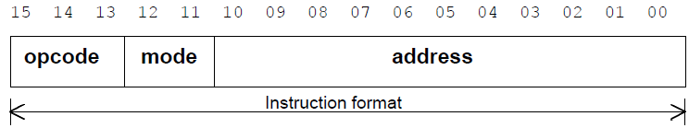
Records
TYPE opcode IS (sta, lda, add, sub, and, nop, jmp, jsr);
TYPE mode IS integer RANGE 0 TO 3;
TYPE address IS BIT_VECTOR (10 DOWNTO 0);
TYPE instruction_format IS RECORD
opc : opcode;
mde : mode;
adr : address;
END RECORD;

Slide 17

Aliases
architecture EXAMPLE of ALS is signal DATA is bit_vector(9 downto 0); alias STARTBIT : bit is DATA(9) ; alias MESSAGE: bit_vector(6 downto 0) is DATA (8 downto 2); alias PARITY: bit is DATA(1); alias STOPBIT: bit is DATA(0); alias REVERSE: bit_vector(1 to 10) is DATA; function calc_parity(data: bit_vector) return bit is . . . begin STARTBIT <= '0'; MESSAGE <= "1100011"; PARITY <= calc_parity(MESSAGE); REVERSE(10) <= '1'; end EXAMPLE;
Give new names to already existing objects
Make it easier to handle complex data structures
Aliases are not always supported by synthesis tools

Slide 18
Don’t Care
در سنتز كننده ها مقايسه با ‘-’ در شرطها عموماً نتيجة FALSE مي دهد (هيچگاه مقدار سيگنال = ‘-’ نمي شود):
when (a = “1---”)
….
اگر مثلاً a = “1000” شود شرط TRUE نمي شود.
براي اين منظور مي توان از stdmatch(s1, s2) (در پکيج numeric_std) استفاده كرد:
when (std_match(a, “1---”))
….
همة حالات ‘-’ را آزمايش مي كند.
راه بهتر (portable) : توصیف دقیق:
when (a(3) = ‘1’)
….

